Slide 1
Housing Prices in King County
Samantha Yu
Vasena Jayamanna
Alexander Lo

Slide 2
Dataset
When: May 2014 - May 2015
Where: King County (aka Seattle area)
Response Variable: Housing price
20 Other Variables
ID, bedrooms, bathrooms per bedroom, floors, waterfront, number of views, condition, grade
Date sold, year built, and year renovated
Zip code, latitude, and longitude
Square footage:
Entire home, and lot (at time it was sold and 2015); basement and rest of the house

Slide 3
Data Preparation
Create 3 new features from date sold
e.g. "20141013T000000"
Year: 2014
Month: 10
Day: 13
Remove ID and zip code from dataset

Slide 4
Original Model
All 20 regressors:
price ~ sqft_living + lat + view + grade + yr_built + waterfront +
bedrooms + bathrooms + condition + year_sold + sqft_above +
long + sqft_living15 + yr_renovated + sqft_lot15 + sqft_lot +
day_sold + month_sold + floors + sqft_basement
Adjusted R-squared: 0.6967

Slide 5
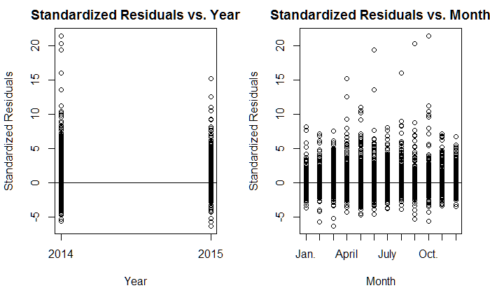

Slide 6
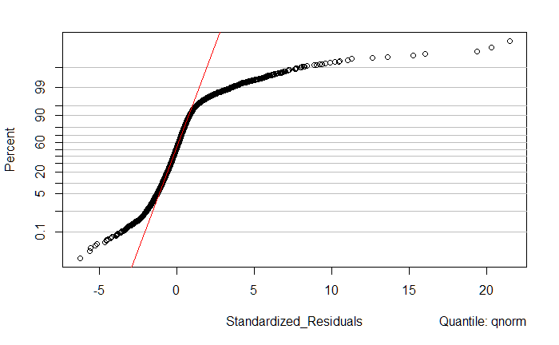
Original Model
Adjusted R-squared: 0.6967
Notes:
Normal probability plot

Slide 7
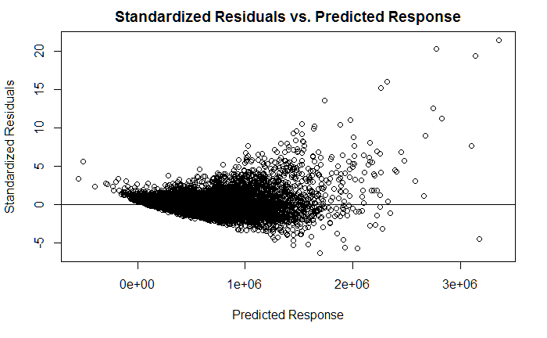
Original Model
Adjusted R-squared: 0.6967
Notes:
Residual plots

Slide 8
Log(Price) Model
All 20 regressors:
log(price) ~ sqft_living + lat + view + grade + yr_built + waterfront +
bedrooms + bathrooms + condition + year_sold + sqft_above +
long + sqft_living15 + yr_renovated + sqft_lot15 + sqft_lot +
day_sold + month_sold + floors + sqft_basement
Adjusted R-squared: 0.7698

Slide 9
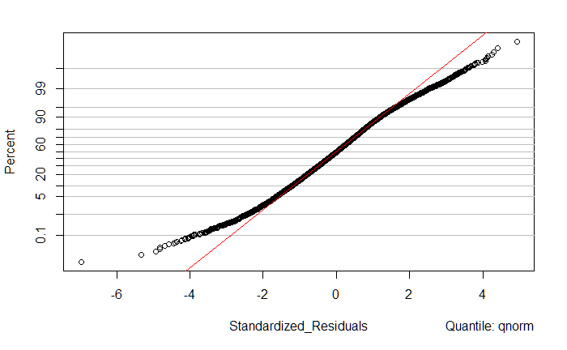
Log(Price) Model
Adjusted R-squared: 0.7698
Notes:
Normal probability plots

Slide 10
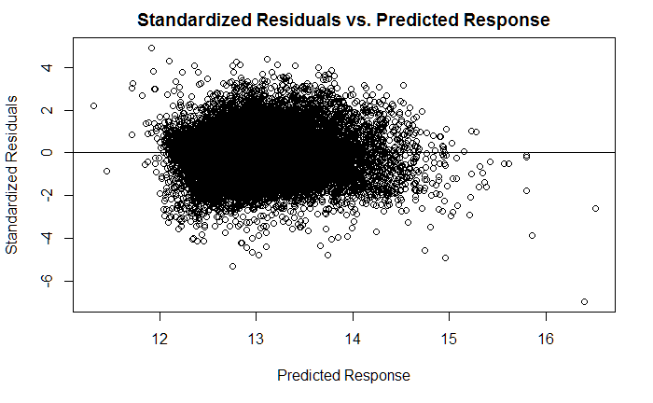
Log(Price) Model
Adjusted R-squared: 0.7698
Notes:
Residual PLot

Slide 11
Variable Selection Methods
Overall: Forwards selection, backwards elimination, and stepwise regression result in the same model
Result: 19 regressors
log(price) ~ sqft_living + lat + view + grade + yr_built + waterfront +
bedrooms + bathrooms + condition + year_sold + sqft_above +
long + sqft_living15 + yr_renovated + sqft_lot15 + sqft_lot +
day_sold + month_sold + floors + sqft_basement
AIC = -59443.17 Adjusted R Squared = 0.7698

Slide 12
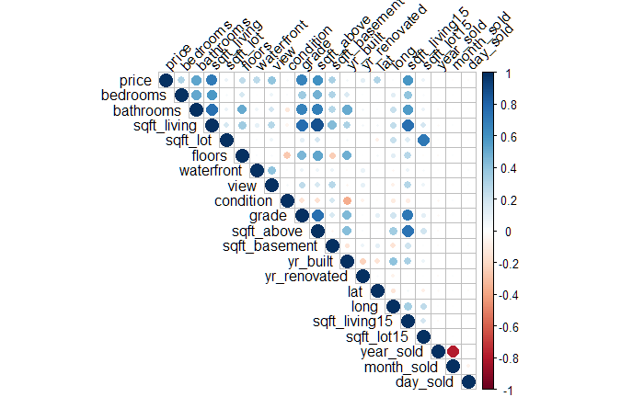
Correlation

Slide 13
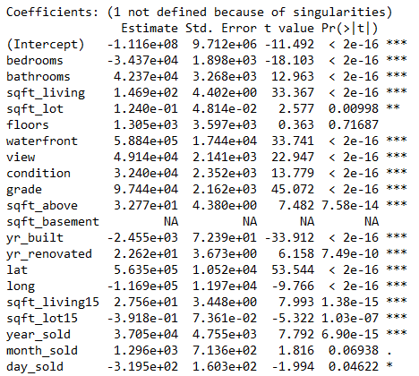
Multicollinearity
A linear model with all of our regressors results in a row of NAs in our summary
So we have multicollinearity

Slide 14
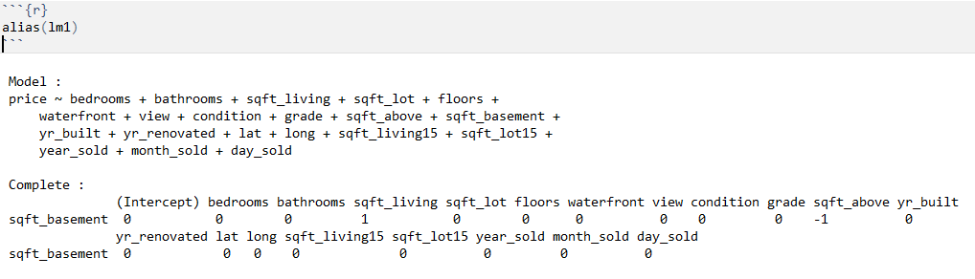
Multicollinearity
Using the alias() function, we can identify linearly dependent terms
Notes:
We tried different configurations after this, removing sqft_living, sqft_above, and sqft_basement independently, and found the best results with just removing sqft_basement

Slide 15
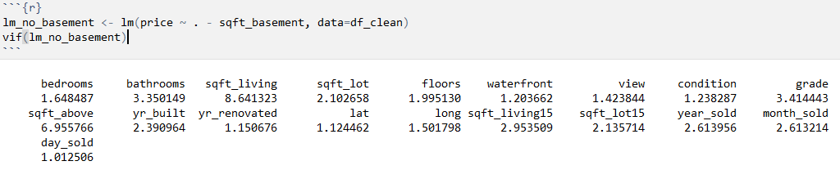
Multicollinearity
We removed sqft_basement, but found that we still had VIFs > 5 for sqft_living and sqft_above
Although the row of NAs in the summary were dealt with
Notes:
A potential solution to dealing with multicollinearity is ridge regression

Slide 16
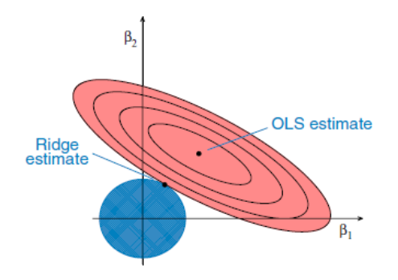

Ridge Regression
Ellipses: contours of RSS
Smaller ellipses have smaller residual sum of square values
Circle:
limit the sum of the squared coefficients
OLS:
Minimize
Ridge:
Minimize
Penalty term
Notes:
https://onlinecourses.science.psu.edu/stat857/node/155/ - for the diagram and notes on it
I.e. we want to minimize the sum of the squared coefficients (multiplied by penalty λ) while increasing the residual sum of squares a little (and consequently increasing variance)
Lambda between 0 and positive infinity

Slide 17
Ridge Regression
All regressors included in the model:
"bedrooms” "bathrooms" "sqft_living" "sqft_lot" "floors" "waterfront" "view" "condition" "grade" "sqft_above" "yr_built" "lat" "long" "sqft_basement" "yr_renovated" "sqft_lot15" "year_sold" "month_sold" "day_sold" "sqft_living15"
Split the housing data into: training set, validation set
cv.glmnet: to run cross-validation on the training set to find optimal lambda
Use resulting lambda to → predict coefficients → to calculate the MSE
Refit using all data
Notes:
price with all other regressors included in the model
split the housing data into
training set for model fitting, and
validation set for estimating the error

Slide 18
Ridge Regression
All regressors included in the model:
"bedrooms” "bathrooms" "sqft_living" "sqft_lot" "floors" "waterfront" "view" "condition" "grade" "sqft_above" "yr_built" "lat" "long" "sqft_basement" "yr_renovated" "sqft_lot15" "year_sold" "month_sold" "day_sold" "sqft_living15"
Split the housing data into: training set, validation set
cv.glmnet: to run cross-validation on the training set to find optimal lambda
Use resulting lambda to → predict coefficients → to calculate the MSE
Refit using all data
Notes:
used cv.glmnet to run 10-fold cross-validation on the training dataset to find the optimal lambda
The default for cv.glmnet is 10 fold

Slide 19
Ridge Regression
All regressors included in the model:
"bedrooms” "bathrooms" "sqft_living" "sqft_lot" "floors" "waterfront" "view" "condition" "grade" "sqft_above" "yr_built" "lat" "long" "sqft_basement" "yr_renovated" "sqft_lot15" "year_sold" "month_sold" "day_sold" "sqft_living15"
Split the housing data into: training set, validation set
cv.glmnet: to run cross-validation on the training set to find optimal lambda
Use resulting lambda to → predict coefficients → to calculate the MSE
Refit using all data
Notes:
used resulting lambda to → predict coefficients
used predicted coefficients → to calculate the MSE on the test set
Refit the model using the full data set

Slide 20
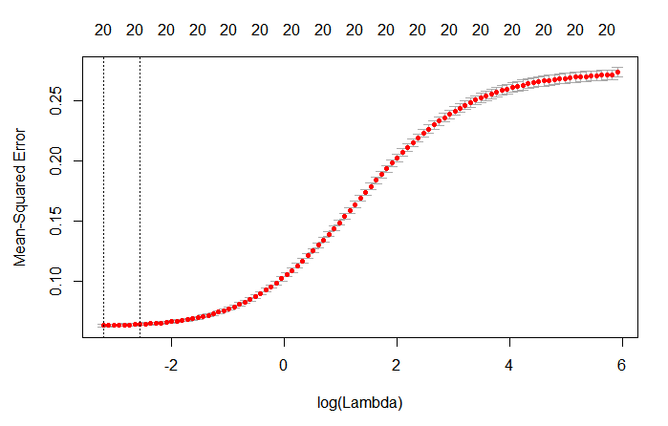
Ridge Regression
Lambda.min = 0.04026129
MSE = 0.06530581
Lambda.1se = 0.07721754
MSE = 0.0662758
Notes:
We went with lambda min, as for ridge regression the main difference between the two is the MSE, not the number of variables.
Although the mse difference is marginal, lambda.min is still better

Slide 21
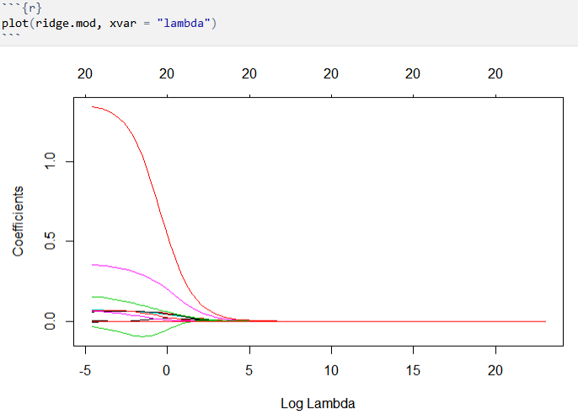
Ridge Regression
 | Model
Adjusted R squared | 0.7679732
MSE | 0.06530581
Number of variables | 20
Notes:
Note that while the coefficients are shrunk “towards” zero as log(lambda) increases, the number of variables in the model stays the same, as with ridge regression we can shrink coefficients but not remove them entirely
Note that we log-transformed the response variable

Slide 22
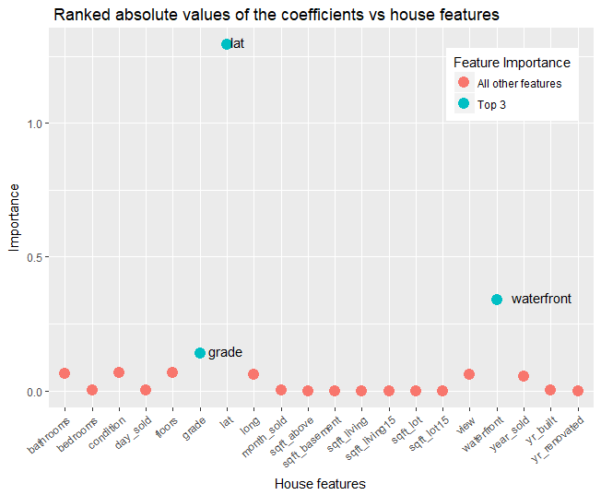
varImp(ridge.mod,
lambda = bestlam)
Latitude (location)
Waterfront (by the waterfront or not)
Grade (King County system grade, per house)
Notes:
varImp in the carets package
Note, the house feature with values near the bottom of the plot have “near-zero” coefficients, not actually zero ones
Grade is from 1-13, indicates the level of construction and design

Slide 23
Lasso (Least Absolute Shrinkage Selection Operator)
Performs shrinkage and variable selection
Shrinkage of the coefficients to or towards 0
Variable selection if shrunk to 0
Does this by imposing a penalty
Penalty = λ*Sum| all model parameters |
Goal: Minimize SSres + penalty
λ is the tuning parameter
As it increases, the bias increases, and the variance decreases
Controls the strength of the penalty
The optimal λ is found using cross-validation
Notes:
Point 1 .It is similar to ridge regression however the main difference is lasso can perform variable selection, unlike ridge, lasso is able to shrink the coefficients to and towards 0. Variable selection only keeps the important regressor variables while removing the others. This is performed when unimportant coefficients are shrunk to 0 because they are removed from the model
Point 2. All of this is done by imposing a penalty. The penalty is lambda times the sum of the absolute value of all parameters. Similar to ridge, our goal is to minimize SSres plus the penalty, however the penalties differ
Point3 Lambda is the tuning parameter. It controls the strength of the penalty. When lambda increases, the bias increases, the variance decreases, more coefficients are shrunk to 0 which means the model will be left with fewer predictions. Lasso is better than ridge regression at reducing the variance in models with many useless variables
When lambda is 0, the penalty goes to 0 and we are left with least squares. Like ridge, The optimal λ is found using cross-validation on the training set

Slide 24
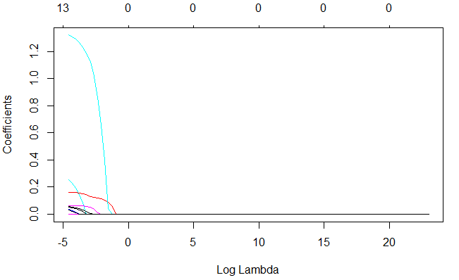

Slide 25
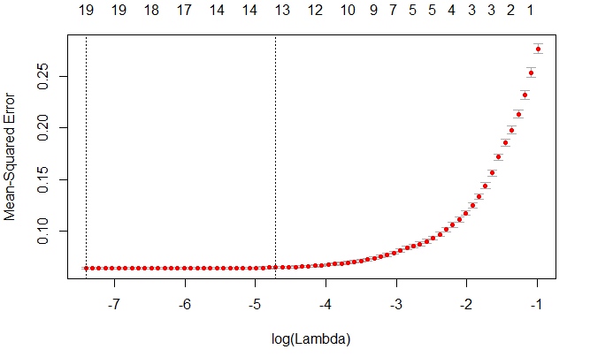
Lambda.min
MSE = 0.06558256
Lambda.1se
MSE = 0.06558256

Slide 26
Conclusion
Models | AIC | Adjusted R Squared | MSE | # of variables
Stepwise / forward / backward selection | -59443.17 | 0.7698 | 0.06378777 | 19
LASSO | NA | 0.7654432 | 0.06558256 | 13
Ridge | NA | 0.7679732 | 0.0646233 | 20
Log(Price) ~ bedrooms + bathrooms + sqft_living + sqft_lot + floors +
waterfront + view + condition + grade + sqft_above + sqft_basement +
yr_built + yr_renovated + lat + long + sqft_living15 + sqft_lot15 + year_sold +
month_sold + day_sold

Slide 27
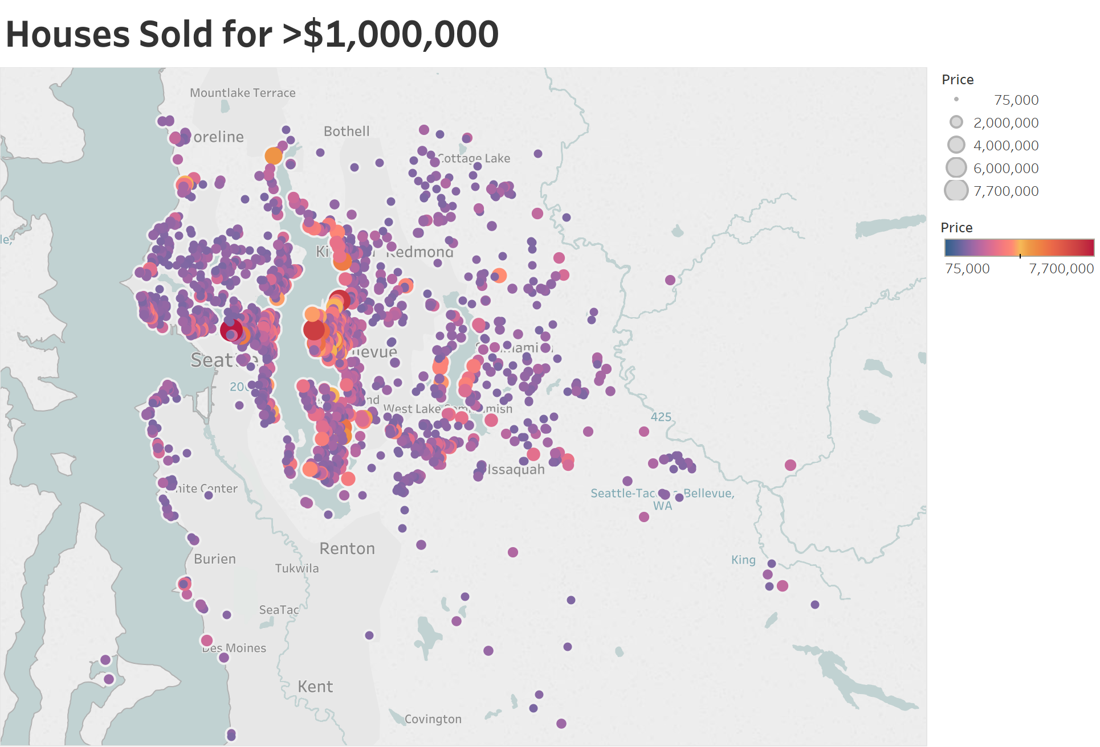

Slide 28
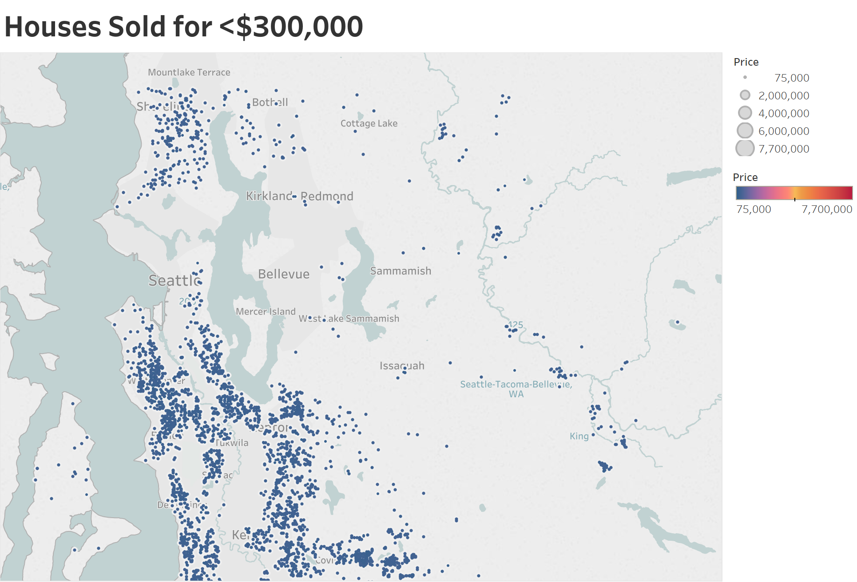

Slide 29
Thank you!

